Slide 1
CIE 4400 Water Quality Modeling Completely & incompletely mixed systems
Saket Pande

Slide 2
Completely mixed systems
Water mass balance
+
Pollutant mass balance
Notes:
What are the inputs, outputs ? Think of all hydrological terms!

Slide 3


Fundamental equation (one dimensional)
W
A_{c}
Mass Balance of water
J_{in}
J_{out}
Mass Balance of pollutants
∆x
∆V: Volume of differential element (L³)
J_{in}: Ingoing mass flux rate (ML⁻²/T)
J_{out}: Outgoing mass flux rate (ML⁻²/T)
A_{c}: Cross sectional area (L²)
∆x: Length of differential element (L) = ∆V/ A_{c}
c: concentration of the pollutant (ML⁻³)
Accumulation = Inflow – Outflow– Reaction + Loading

Slide 4
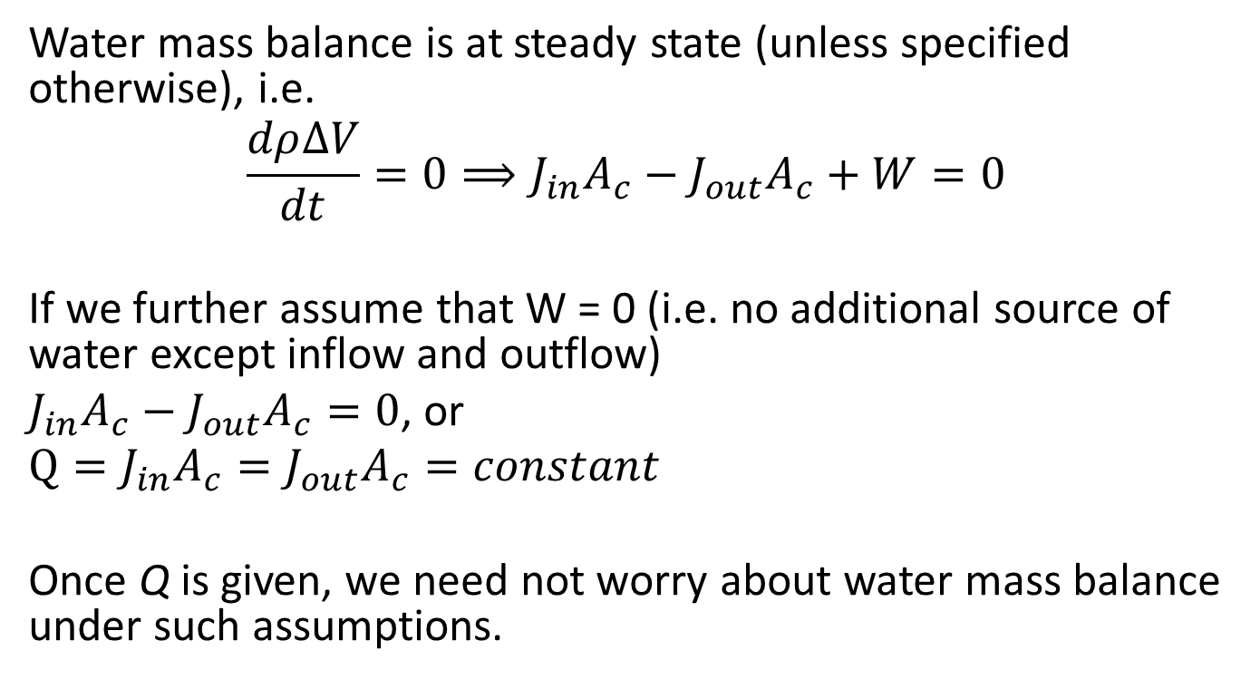
Basic water balance assumptions (unless specified otherwise)
Water mass balance is at steady state (unless specified otherwise), i.e.
$$\frac{dρ∆V}{dt}=0⟹J_{in}A_{c}−J_{out}A_{c}+W=0$$
If we further assume that W = 0 (i.e. no additional source of water except inflow and outflow)
$J_{in}A_{c}−J_{out}A_{c}=0$, or
$$Q=J_{in}A_{c}=J_{out}A_{c}=constant$$
Once Q is given, we need not worry about water mass balance under such assumptions.

Slide 5
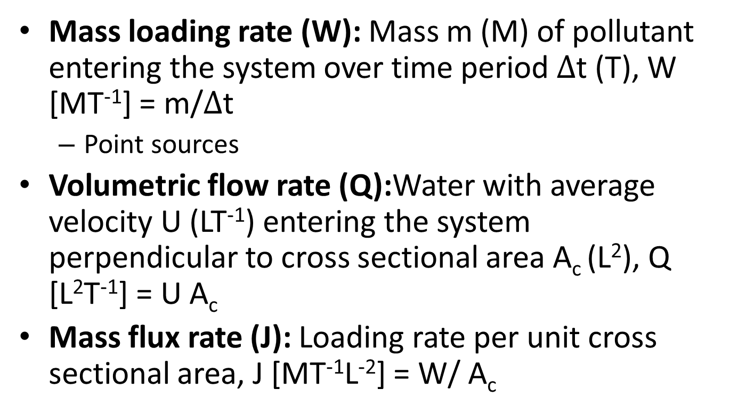
Some definitions
Mass loading rate (W): Mass m (M) of pollutant entering the system over time period $∆$t (T), W [MT⁻¹] = m/$∆$t
Point sources
Volumetric flow rate (Q):Water with average velocity U (LT⁻¹) entering the system perpendicular to cross sectional area A_{c} (L²), Q [L²T⁻¹] = U A_{c}
Mass flux rate (J): Loading rate per unit cross sectional area, J [MT⁻¹L⁻²] = W/ A_{c}

Slide 6
Completely mixed systems
Different from water mass balance ?
Loading
Inputs State variables Outputs
Well-mixed
reservoir
Outflow
Inflow
Settling
Reactions
Accumulation = Inflow – Outflow – Reaction – Settling + Loading
Notes:
Precipitation, evaporation and infiltration into the subsoil included in the loading / outflow

Slide 7
Loading types in the pollutant balance
Accumulation =Inflow – outflow - settling – reaction + Loading
Impulse loading (W = W0δ(t)): W0 is the mass loading rate of pollutant entering the system over a relatively short period of time. Here δ(t) is a dirac delta function
Accidental spill
Step Loading (new continuous source): When loading rate changes from 0 to a constant value at some point in time.
Pollution from industrial activities (eg chemical plants)
Pulse loading (difference between two step loadings starting at different times): Loading rate jumps from 0 to a constant for a period of time and then jumps back to zero.
Start and end of an industrial pollution activity.

Slide 8
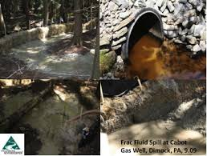
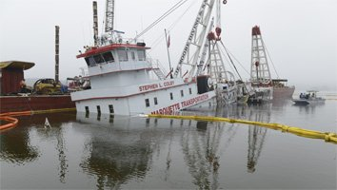
Impulse loading?
Step loading?
Pulse loading?

Slide 9
Reaction kinetics
Reaction kinetics
Zero, first or second order?
C(t)
t
ln(C(t)
t
1/C(t)
t

Slide 10

Reaction kinetics
First order reactions are only considered in this class
Time scale of the process
C(t)
C₀
Time t
1 / k

Slide 11
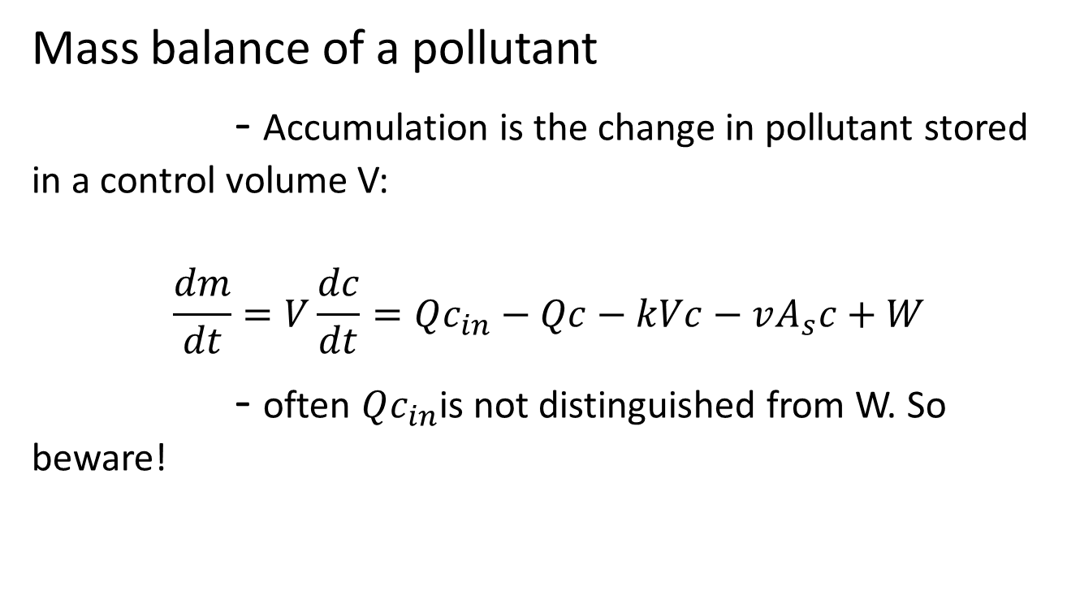
SUMMARY
Accumulation = Inflow – outflow - settling – reaction + Loading
Mass balance of a pollutant
- Accumulation is the change in pollutant stored in a control volume V:
$$\frac{dm}{dt}=V\frac{dc}{dt}=Qc_{in}−Qc−kVc−vA_{s}c+W$$
- often $Qc_{in}$is not distinguished from W. So beware!

Slide 12

Completely mixed systems
How about:
Susceptibility of a system to pollution?
steady state analysis, i.e. when
Time to recovery after pollutant loading?
Solution of a linear differential equation

Slide 13


Susceptibility to pollution (steady state)
Completely mixed system at steady-state
where a is called assimilation factor that depends on the outflow rate, reaction kinetics of the system, settling velocity and settling area. Thus the assimilation factor partly depends on the intrinsic properties of a system.
Higher assimilation factor, less susceptible to pollution
Notes:
Well discussed in Chapra’s book,
assimilative capacity
Definition
Capacity of a natural body of water (lake, river, sea, etc.) to receive waste waters or toxic materials, without harmful effects and damage to aquatic life and to humans who consume its water.

Slide 14
End of hour 2

Slide 15
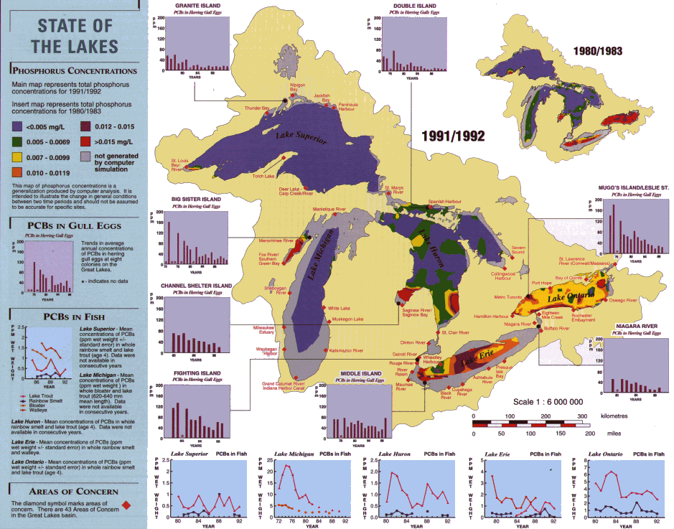

Slide 16


Residence time of pollutants (steady state)
(Mean) Residence time:
- residence time of lake water :
mean residence time of pollutant x: quantity of pollutant (either mass or concentration) in the control volume/absolute value of sources or sinks:

Slide 17




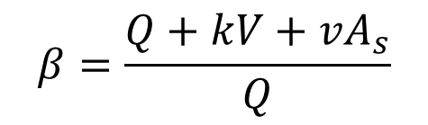

Transfer function of a completely mixed system (steady state)
Q
c
Q
$$c_{in}$$
c
If
$$β=\frac{Q+kV+vA_{s}}{Q}$$
where
So when,
$$β≫1$$
Lake’s removal mechanisms reduce pollution
$$β≈1$$
Small assimilative capacity of the lake
Notes:
Low beta = high a compared to Q
Note: Q appears in the numerator and denominator; it represents delivery (inflow) as well as flushing (outflow)

Slide 18
Pollutant reduction (transient analysis)
Pollutant reduction for step load function
- Load decreases: time to recovery? Shape of recovery?
W(t)
t₀
t
Time to recovery
c(t)
c
Shape of recovery
b
a
t₀
t
Notes:
What do you think? a of b of c?

Slide 19



For further analysis we need the solution for..
Solution:

Slide 20


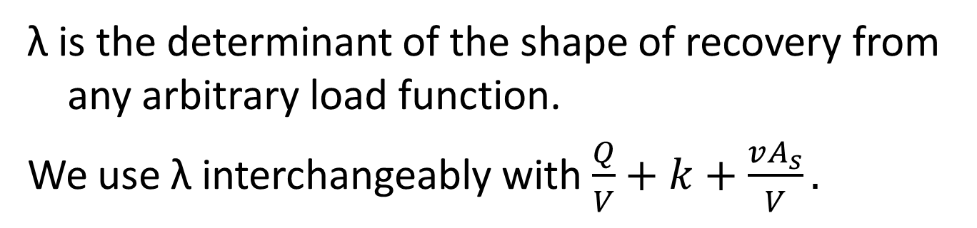
Pollutant reduction from an arbitrary loading
Determinant of the shape of recovery from an arbitrary load function
λ is the determinant of the shape of recovery from any arbitrary load function.
We use λ interchangeably with $\frac{Q}{V}+k+\frac{vA_{s}}{V}.$

Slide 21
Pollutant reduction
How the system behaves once the load stops completely at t = t₀ (pulse load) with the concentration of the system at c₀ ?
For t>t₀
What time concentration of the system reached 10% of c₀?
C(t)
c₀
c₁₀
t₀
t10
t

Slide 22
Pollutant reduction: Solutions for different loading functions
Solutions for particular functional forms of W(t)
Impulse load
Step load
W(t)
t
W(t)
t

Slide 23



Pollutant reduction: impulse load
Impulse load ($W(t) =m_{0}δ(t0)$)= load that stops immediately
c(t)
Solution:
m₀/V
t₀
t

Slide 24

Pollutant reduction: step load
Step load = continuous load after t₀, i.e.
C(t)
Solution:
W_{cst} /(λV)
t₀
t

Slide 25
Pollutant reduction
Solution for arbitrary load
Assumption: linear system (show that we have been working with a linear system!)
effect (load 1 + load 2) = effect (load 1) + effect (load 2)
effect (2 * load 1) = 2* effect (load 1)
W(t)
t
C(t)
C(t)
Sum them up

Slide 26

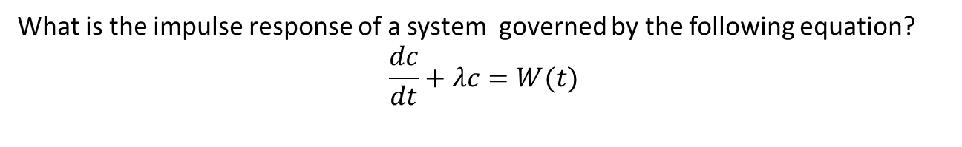
Pollutant reduction
Solution for arbitrary load
W(t)
Impulse loading
t
Convolution
C(t)
C(t)
t
response
= response of impulse unit loading
What is the impulse response of a system governed by the following equation?
$$\frac{dc}{dt}+λc=W(t)$$
$$IR\left(τ\right)=e^{−λτ}$$

Slide 27
End of hour 3

Slide 28
Incompletely mixed system

Slide 29
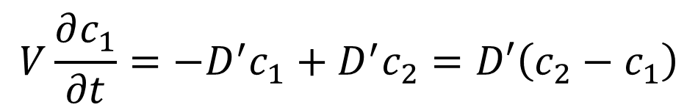
A conceptual model for diffusion
V
D’
c₁
c₂
D’
A feedback system with equal volumetric flow D’ (similar to λ?) in both the directions
Two well mixed reservoir of constant volume V
$$V\frac{∂c_{1}}{∂t}=−D^{′}c_{1}+D^{′}c_{2}=D′\left(c_{2}−c_{1}\right)$$

Slide 30
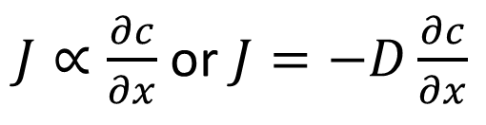
Ficks first law for diffusion
$J∝\frac{∂c}{∂x}$ or $J=−D\frac{∂c}{∂x}$
Mass flux is proportional to the gradient of concentration with a sign opposite to that of the gradient

Slide 31
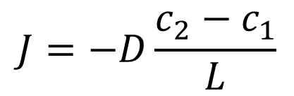

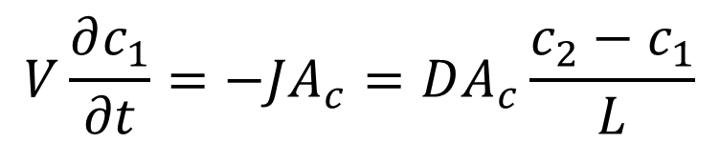
Further scrutiny of Fick’s law
A_{c}
V
D’
c₁
c₂
D’
$$L$$
Discretize Fick’s law for the above case:
$$J=−D\frac{c_{2}−c_{1}}{L}$$
Apply conservation of mass to the left reservoir:
$$V\frac{∂c_{1}}{∂t}=−JA_{c}=DA_{c}\frac{c_{2}−c_{1}}{L}$$

Slide 32
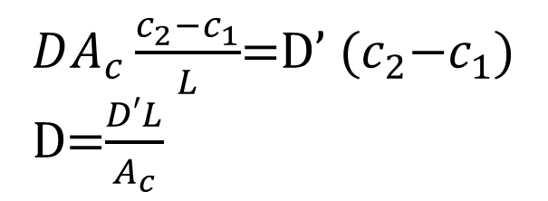
What is diffusion/dispersion coefficient?
A_{c}
V
D’
c₁
c₂
D’
$$L$$
$DA_{c}\frac{c_{2}−c_{1}}{L}$=D’ ${(c}_{2}−c_{1}$)
D=$\frac{D′L}{A_{c}}$
Represents the intensity of mixing
Depends on “mixing length” and cross sectional area of mixing
Therefore scale dependent

Slide 33
Variants of diffusion
Diffusion
Dispersion
Conduction
Convection

Slide 34
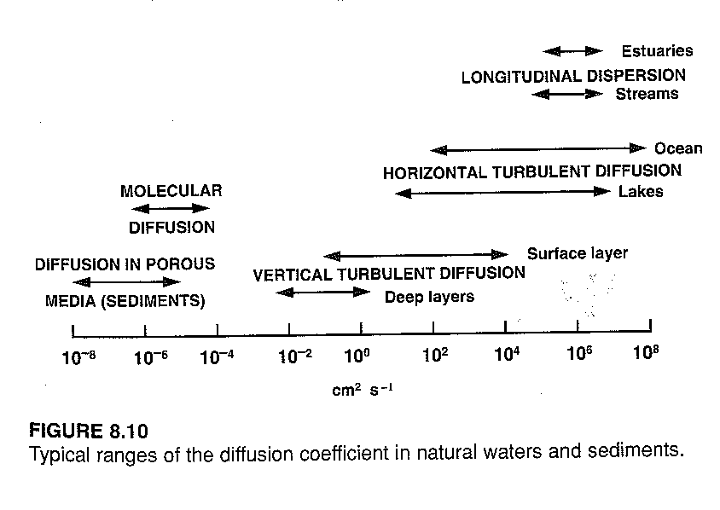
Diffusion coefficients
Turbulent diffusion coeff.: property of the fluid
D_{turb} >>D_{diff} (eddies >> larger than molecule motion)
cm²/s
Source: Book Chapra

Slide 35
Types of spills
Instantaneous point spill: a spill (or loading) at one instance in time and one point in space
Continuous point spill: a spill continuous in time but at one point in space
Instantaneous nonpoint/distributed spill: ?
Continuous nonpoint/distributed spill: ?

Slide 36
Fundamental equation (one dimensional)
W
A_{c}
Mass Balance of water
J_{in}
J_{out}
Mass Balance of pollutants
∆x
∆V: Volume of differential element (L³)
J_{in}: Ingoing mass flux rate (ML⁻²/T)
J_{out}: Outgoing mass flux rate (ML⁻²/T)
A_{c}: Cross sectional area (L²)
∆x: Length of differential element (L) = ∆V/ A_{c}
c: concentration of the pollutant (ML⁻³)

Slide 37
Diffusion (or Dispersion or Convection) equation for a differential element
W
A_{c}
J_{in}
J_{out}
∆x
$$∆V\frac{∂c}{∂t}=J_{in}A_{c}−J_{out}A_{c}±reactions+W$$
$J_{in}=−D\frac{∂c}{∂x}$; $J_{out}$=?
Why?

Slide 38
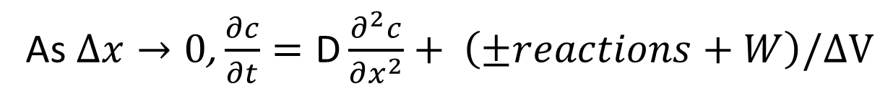
Creating an ordinary differential equation from a differential element
W
A_{c}
J_{in}
J_{out}
∆x
As $∆x→0$, $\frac{∂c}{∂t}=\text{D}\frac{∂^{2}c}{∂x^{2}}+ \left(±reactions+W\right)/∆V$
Formulate diffusion equation with a first order decay equation and W = 0 (in groups)
What if W>0 but a point source ? (in groups)

Slide 39
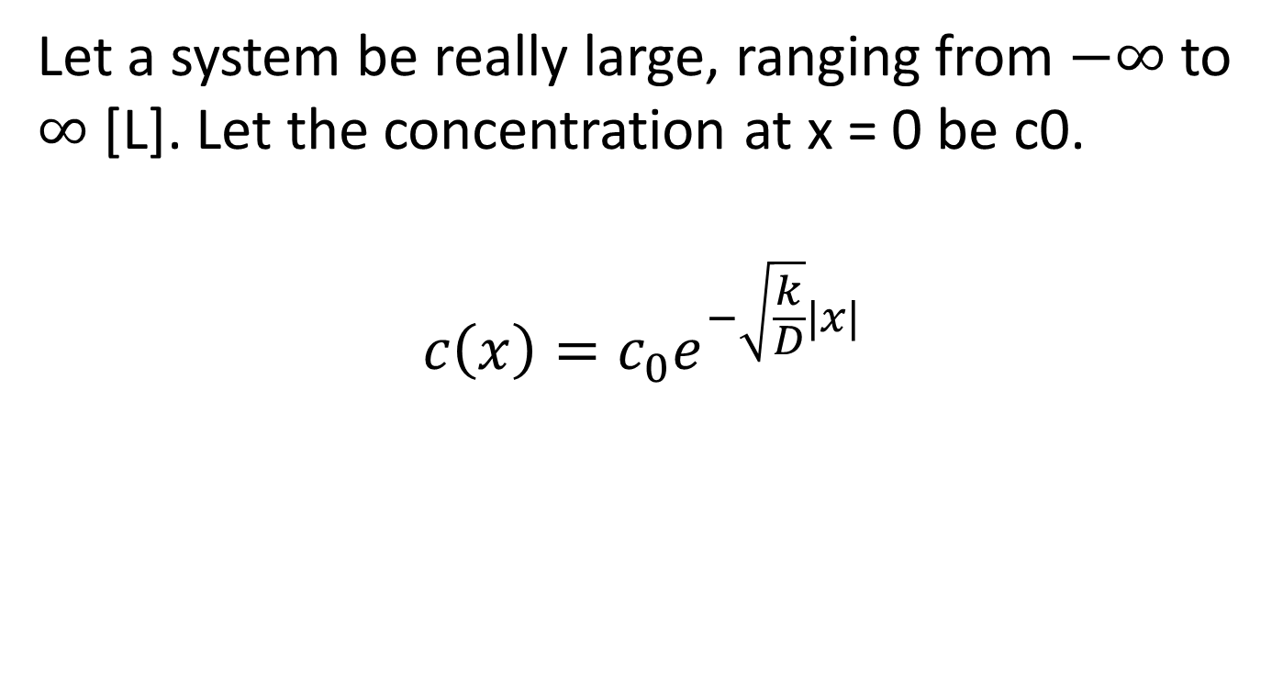
Steady state solution for diffusion equation with decay
Let a system be really large, ranging from $−∞$ to $∞$ [L]. Let the concentration at x = 0 be c0.
$$c\left(x\right)=c_{0}e^{−\sqrt{\frac{k}{D}}|x|}$$

Slide 40
Molecular Diffusion (feel it)
Evolution of a colored droplet on lake surface
What happens to concentration?
(in groups)
Top view
t0
y
t1
x
t2
c(x)
at t1, at t2?
x

Slide 41
Advection only
Center of mass of a differential pollutant mass flows with constant velocity U
$$Mass Flux: J=Uc$$
1D plug flow model
Time step t₀
river
wasteload
real profile
Time step t₁
ideal plug flow

Slide 42
1D Plug Flow Model
A_{c}
c_{in}
c_{out}
Q
Q
∆x
$$∆V\frac{∂c}{∂t}=J_{in}A_{c}−J_{out}A_{c}±reactions+W$$
$J_{in}=Uc$; $J_{out}$=?
Formulate the differential equation for reaction = k∆Vc, and W= 0

Slide 43
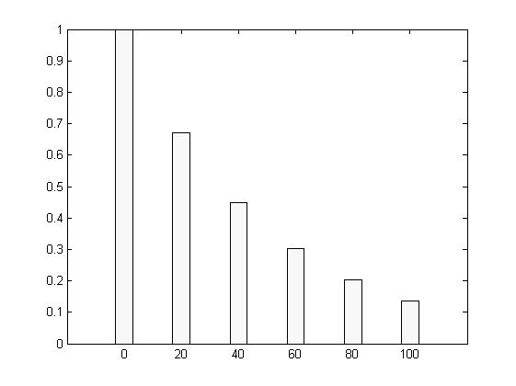
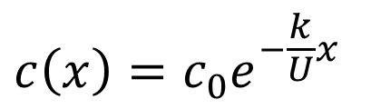
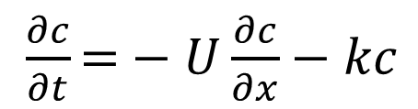
Steady state solution for 1D plug flow model with first order kinetics
Let c(t, x=0) = c₀
$\frac{∂c}{∂t}\text{=}−U\frac{∂c}{∂x}−kc$
Steady state
solution?
c(x) (mg/L)
$$c\left(x\right)=c_{0}e^{−\frac{k}{U}x}$$
For example:
c₀=1mg/L, k= 2/hr, U = 100 m/hr, Ac = 10 sq m, L = 100 m
X (m)

Slide 44
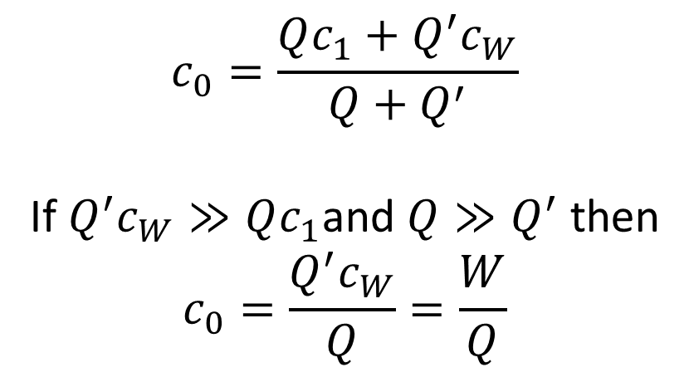

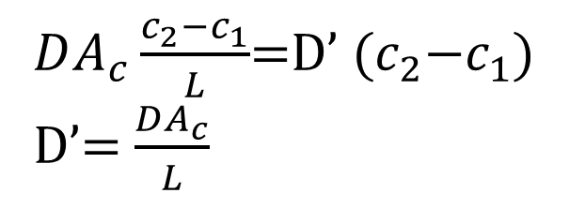
Why c₀ = W/Q under no diffusion when the point (continuous) loading at x = 0 is W
$$Q{′c}_{W}=W$$
$$Qc_{1}$$
$$c_{0}$$
$$Q_{2}c_{0}$$
$$Qc_{1}+Q^{′}c_{W}−Q_{2}c_{0}=0$$
$$Q+Q^{′}=Q_{2}$$
x=0
Differential element, well mixed and at steady state
$$c_{0}=\frac{Qc_{1}+Q^{′}c_{W}}{Q+Q^{′}}$$
If $Q^{′}c_{W}≫Qc_{1}$and $Q≫Q^{′}$ then
$$c_{0}=\frac{Q^{′}c_{W}}{Q}=\frac{W}{Q}$$

Slide 45

Cascade Model of an elongated tank
Feed forward system with first order decay at steady state
A well mixed reservoir of volume V
c_{in}
c_{out}
Q
Q
n well mixed reservoirs
∆x
Solution:

Slide 46
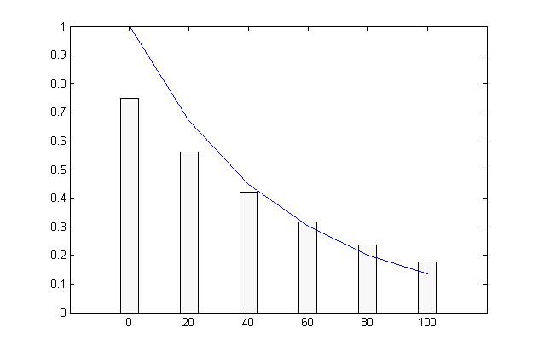
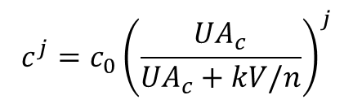
Cascade Model: feedforward system of completely mixed tanks
If V is the total control volume and there are n=6 well mixed reservoirs.
Concentration in the j^{th} reservoir is given by:
Plug Flow model
c(x) (mg/L)
Cascade model
X (m)
When is cascade model equivalent to 1D plug flow model ?

Slide 47
Approximating incompletely mixed condition by piecewise completely mixed systems
Fundamental to modeling heterogeneous concentration fields
For example: cascade model approached plug flow model at n →∞.
How is the formulation of a cascade model different from Plug flow model formulation?

Slide 48
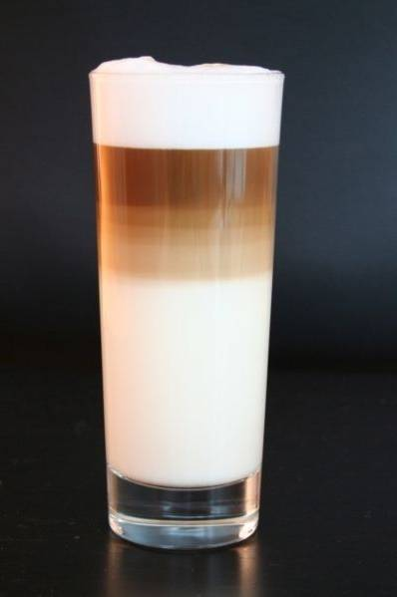
Extending the completely mixed system model
Incomplete mixing: network of box models
Water compartments
Fluxes between compartments ?

Slide 49
Mixed flow model (Advection + Dispersion)
A_{c}
c_{in}
c_{out}
Q
Q
∆x
Advective and dispersive fluxes are additive.
Formulate the mass balance equation (in groups)
Solution:

Slide 50
ADE equation with first order decay process
$\frac{∂c}{∂t}\text{=}−U\frac{∂c}{∂x}+D\frac{∂^{2}c}{∂x^{2}}−kc$
c
x
1) How would the concentration distribution propagate when some instantaneous point spill leading to c(x=0,t=0)=c0 and no reactions or additional loading? (in groups)

Slide 51
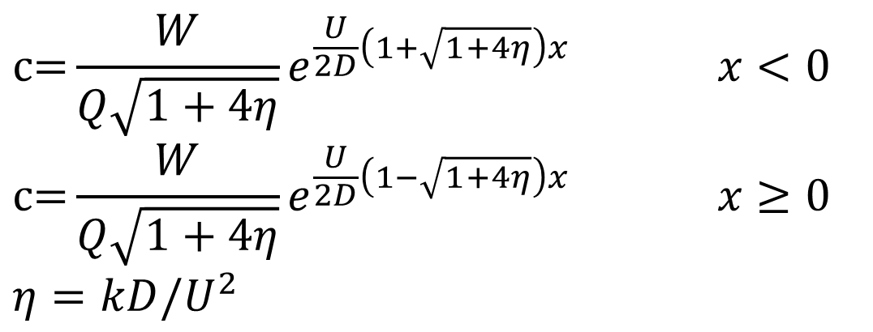
Steady state solution for Mixed flow model
Due to point (continuous) loading W(x) = Wδ(0) at x = 0
$$c\text{=}\frac{W}{Q\sqrt{1+4η}}e^{\frac{U}{2D}\left(1+\sqrt{1+4η}\right)x} x<0$$
$$c\text{=}\frac{W}{Q\sqrt{1+4η}}e^{\frac{U}{2D}\left(1−\sqrt{1+4η}\right)x} x≥0$$
$$η=kD/U^{2}$$
Obtain steady state solution for Plug flow model from this?

Slide 52
End of hour 4

